Slide 1
POSTMAN
Intro to APIs – Class 9

Slide 2

What is Postman?
Postman is an API client that makes it easy for developers to create, share, test and document APIs. This is done by allowing users to create and save simple and complex HTTP/HTTPS requests, as well as read their responses. The result? More efficient and less tedious work!

Slide 3

Why use Postman?
Postman is a great tool for basic debugging; you have the ability to hit your API in every which way and see what your results are!
You can also test for specific results such as verifying for successful HTTP response status (200). These tests can be added to each Postman API call which helps ensure test coverage.
Postman allows users to create collections of their Postman API calls. Each collection can contain subfolders and multiple requests. This helps in organizing your test suites!
A test suite is is a collection of test cases that are intended to be used to test a software program to show that it has some specified set of behaviors.

Slide 4
Why use Postman?
To use Postman, one would need to simply log in to their own account on Postman Web on a machine with internet access, making it easy to access your information anytime, anywhere. (Or you can just download Postman on the machine, whatever works. I prefer the download.)
Collections and environments can be imported or exported, making it easy to share files. A direct link can also be used to share collections.

Slide 5

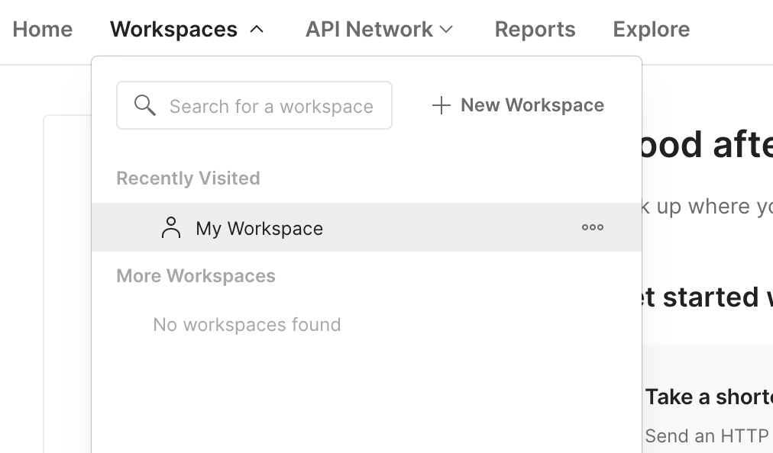
Create an account. Skip the Team information section.
Navigate to your workspace by selecting the Workspaces menu and selecting My Workspace.

Slide 6
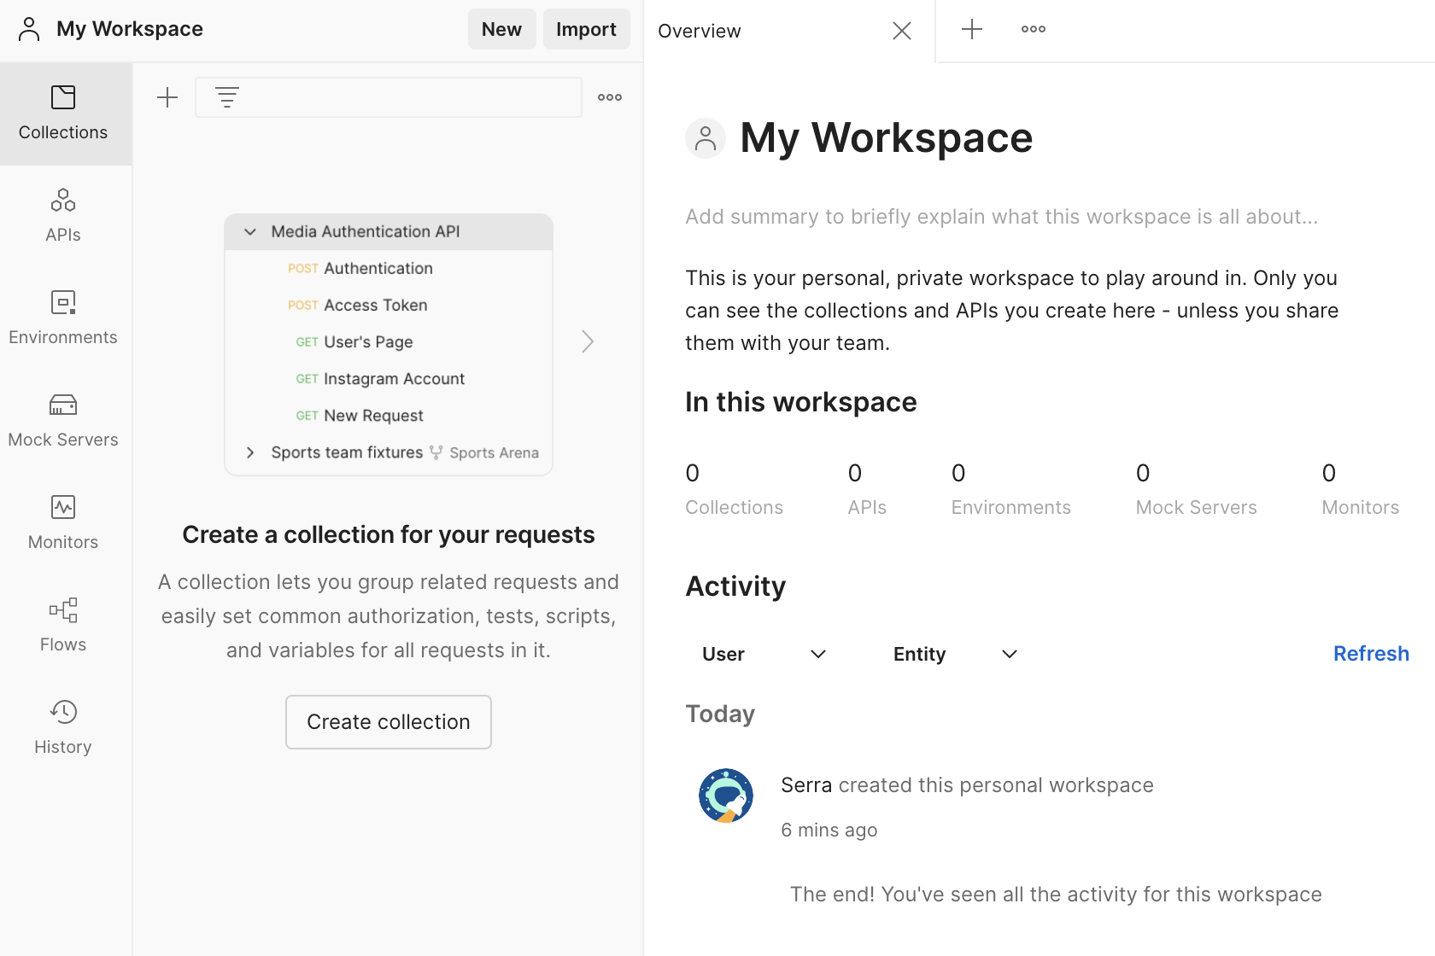
A collection lets you group related requests and easily set common authorization, tests, scripts, and variables for all requests in it.
APIs define related collections and environments under a consistent schema.
An environment is a set of variables that allows you to switch the context of your requests.
Mock servers let you simulate endpoints and their corresponding responses in a collection without actually setting up a back end.
A monitor lets you run a collection periodically to check for its performance and response.
Flows help you test real-world processes by connecting requests logically.
Any request you send in this workspace will appear here.

Slide 7
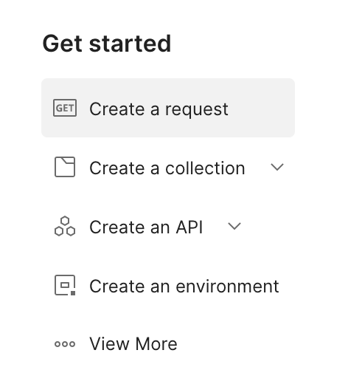
Let’s create a request! Select Create a request from the menu on the right under Get Started.

Slide 8
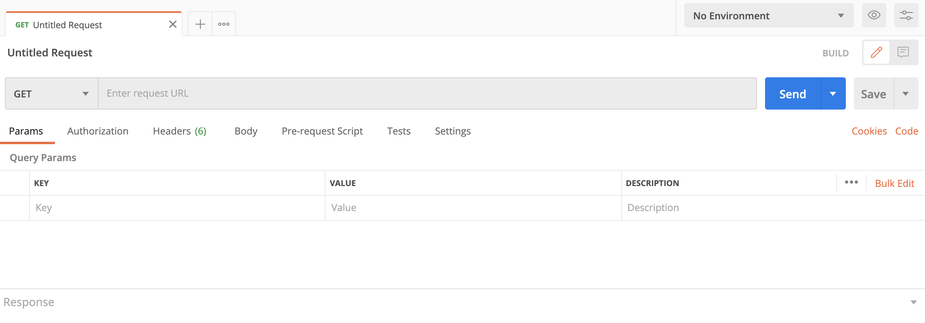
Select an HTTP method.
The request URL goes here.
Query parameters are appended to the end of the request URL, following ? and listed in key-value pairs, separated by &.
Example: ?id=1&type=new
Where you can put your HTTP request body if needed!

Slide 9
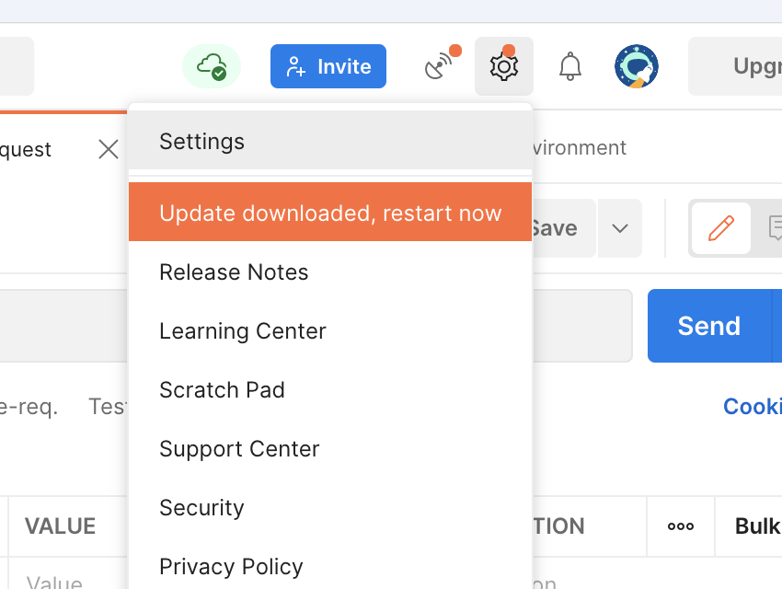
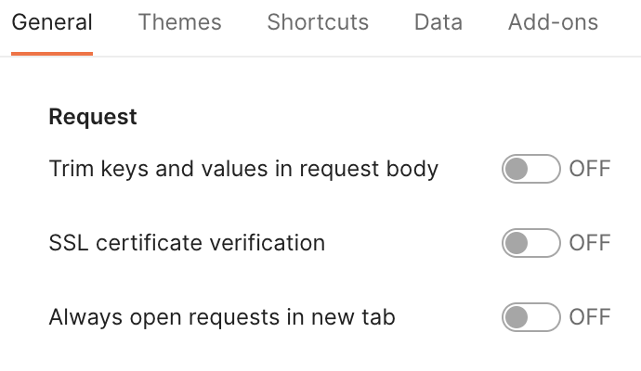
Open the drop-down menu under the small gear icon on the upper right and select Settings.
Turn off the SSL certificate verification option.
Secure Sockets Layer (SSL) certificates are a type of authentication for some servers using the SSL encryption protocol. These certificates provide secure, encrypted communications between a client and a server.
When you add a client certificate to the Postman app, you associate a domain with the certificate. This means that for all HTTPS requests sent to this configured domain, the certificate will be sent along with the request.

Slide 10
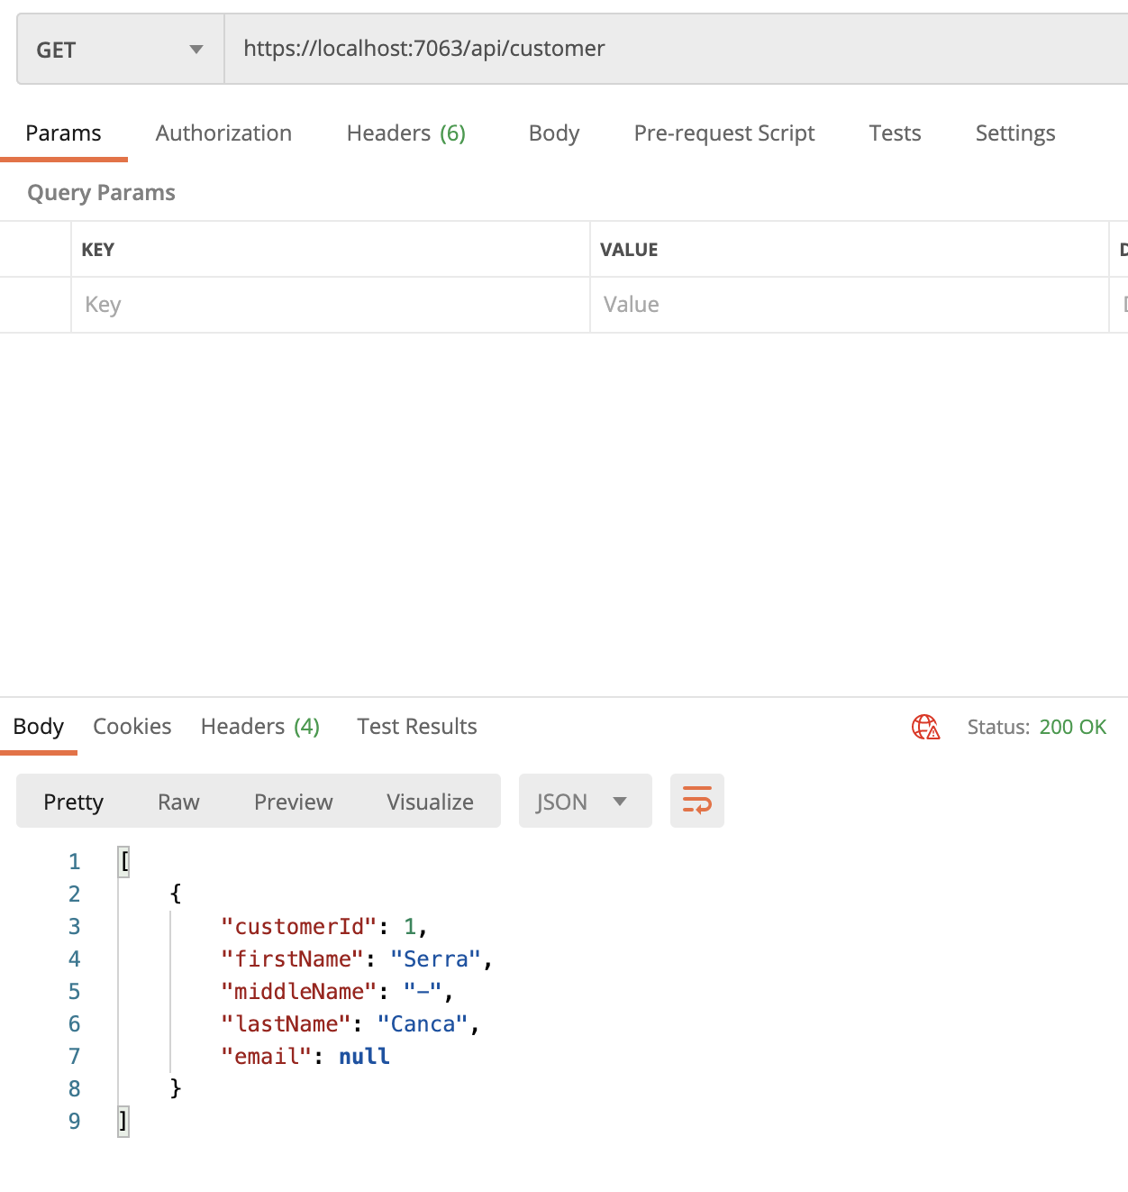
Make sure the HTTP method of our new request is set to GET.
Make sure MySql Server is running. Run the API we put together last class.
Set the request URL as the same URL that our web browser hit when we ran our API program by the end of last class.
Hit Send and you should get everything that is in your Customer table that we set up in our Database class, represented in JSON. Notice the HTTP response status we got back, as well (200 OK).
JavaScript Object Notation (JSON) is a standard text-based format for representing structured data based on JavaScript object syntax.
Try this with other API endpoints, like the API endpoint our client app hit when we did that activity for our Calling an API class!

Slide 11
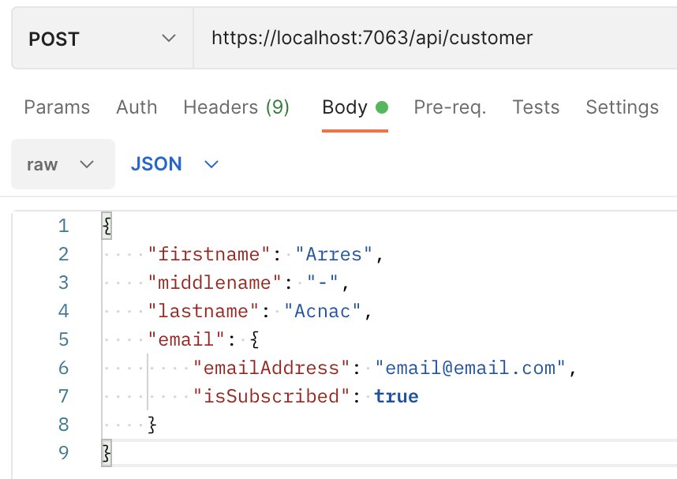
Set the HTTP method as POST.
Now, select the Body tab right below the request URL. Right below that tab select the drop-down menu that says none and set it to raw. Under the Text drop-down menu select JSON.
In our code, every customer has an e-mail. Let’s send a customer with an e-mail over! Fill the body in like shown here and hit Send.
Notice the 201 - Created HTTP response and how we get the created items back in the body of our response.
In your database, check your Customers table and your Emails table that we made in our Database class. ☺

Slide 12
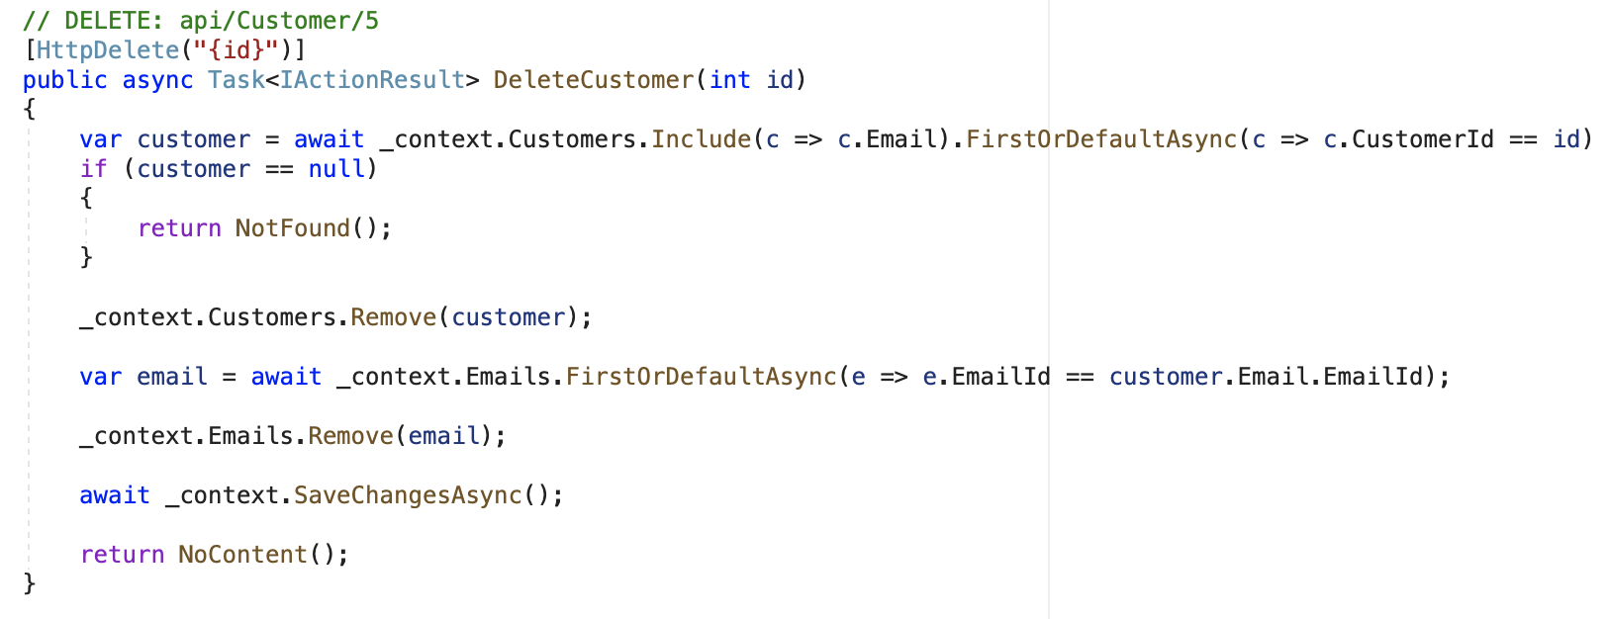
Set the HTTP method as DELETE.
Add the customerId of the new customer record to the end of your request URL (Remember, we set that automatic ID generation up when we were making our tables!)
Change Body to none. No body is expected to be in our HTTP request when deleting objects, according to our API!
Hit Send.
Check out your database tables! Notice how our customer record is gone, but our e-mail record remains.
If you change your DeleteCustomer method in your CustomerController to this, your e-mail will also be deleted. Note how we’re using the Include method in that first line to grab the Email property of our Customer (otherwise, it will always be null).
This is a basic example of some additional logic you’d typically add to an API!

Slide 13
Get the first Customer from the Customers table (_context.Customers) where the id received by the client is equal to the CustomerId, automatically mapping it to a Customer model. Include the mapping of the Email model children.
If no such Customer exists, a default value will be assigned to var customer.
Get the first Email from the Emails table (_context.Emails) where the EmailId is equal to the EmailId of the Customer’s Email.
If no such Email exists, a default value will be assigned to var email.

Slide 14
Try generating an Email controller just as we did for our Customer model previously, when we initially made our API.
If one were to hit the delete method using the appropriate URL (api/email/[id]) and there was still a customer in the Customers table with the same emailId, they’d get an error due to a foreign key constraint. Your Email record is pointing to a Customer record that must be deleted first!

Slide 15
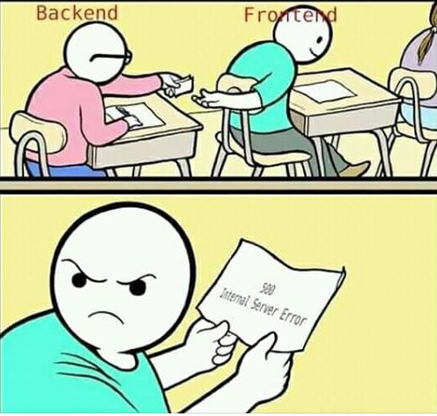
ACTIVITY #6
Screenshot and send over the result of a valid POST call to our practice API!
In said screenshot, please be sure to include the HTTP method, HTTP request URL, HTTP response body, as well as the HTTP response status code.

